Slide 1
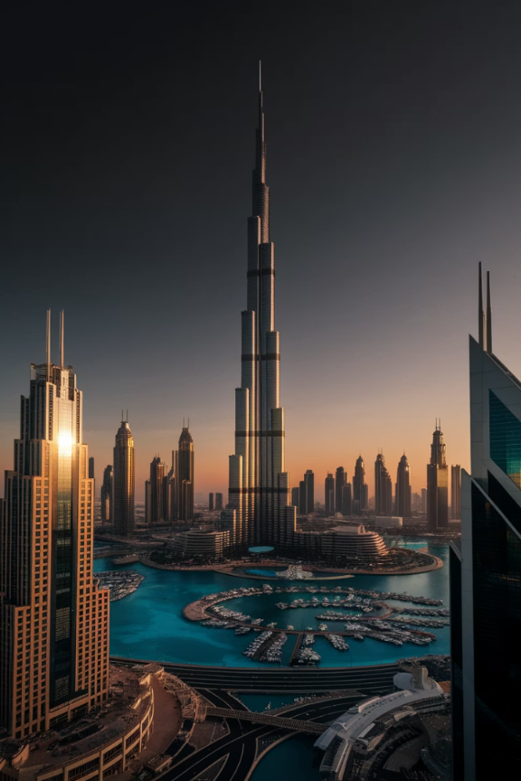


MJ Dream Travel & Tourism: Digital Marketing Strategy
MJ Dream Travel & Tourism specialises in curated Dubai travel experiences for the Cameroonian market. This presentation outlines our comprehensive digital marketing strategy to capitalise on the growing luxury tourism sector, targeting young African aspiring to experience the "Dubai Lifestyle" while leveraging Cameroon's digital growth.
Our approach combines cutting-edge digital trends, competitive analysis, and targeted content strategies to increase qualified leads, build brand awareness, and create an engaged community around the MJ Dream brand.

Slide 2
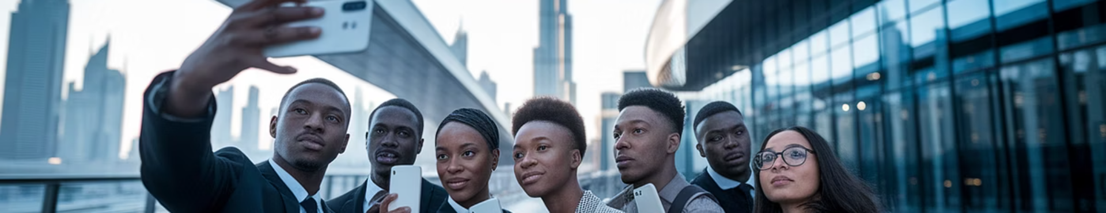



Market Context
Specialised Travel Agency
Growth Opportunity
Digital Landscape
Capitalising on the rise of luxury tourism and young African professionals seeking the "Dubai Lifestyle" experience.
Leveraging the increasing digital adoption in Cameroon to reach and convert potential travellers.
MJ Dream Travel & Tourism focuses exclusively on Dubai tourism packages from the Cameroonian market.

Slide 3

KISS
Cameroon Digital penetration

Slide 4

Digital Statistics

Slide 5
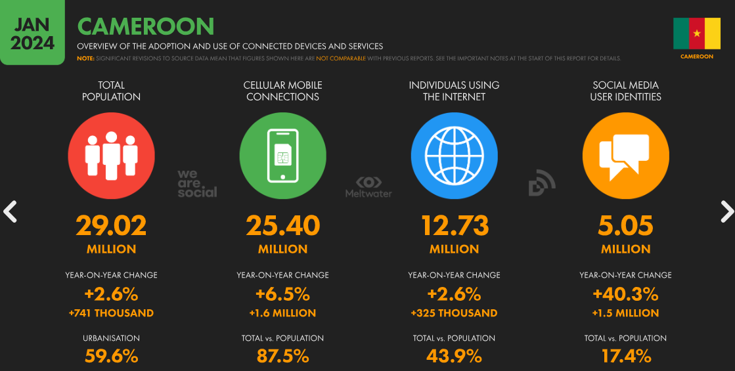

Slide 6
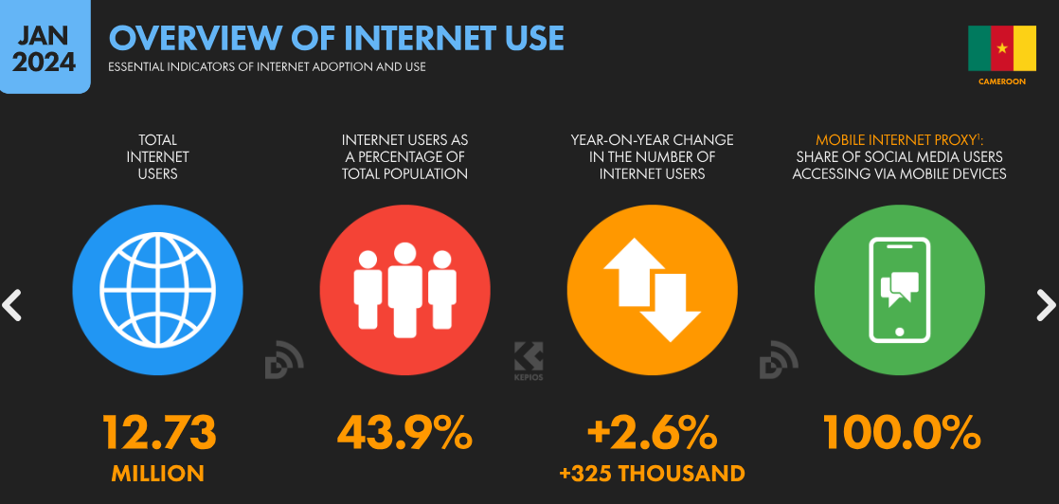

Slide 7
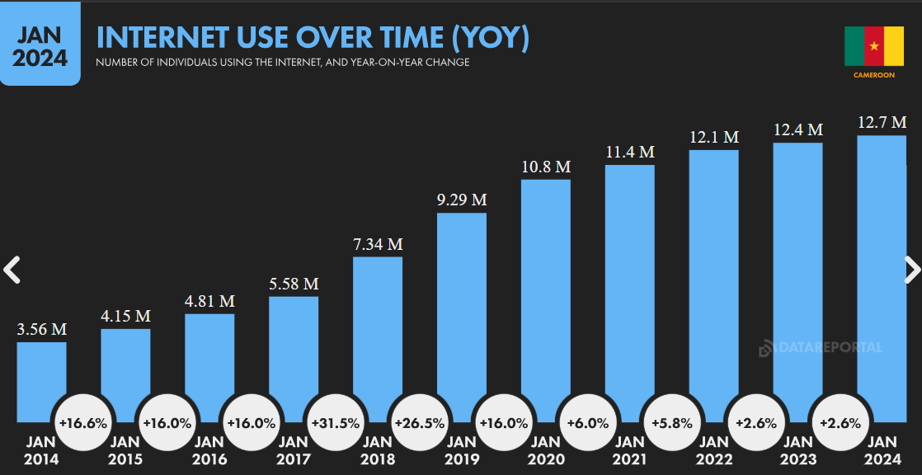

Slide 8
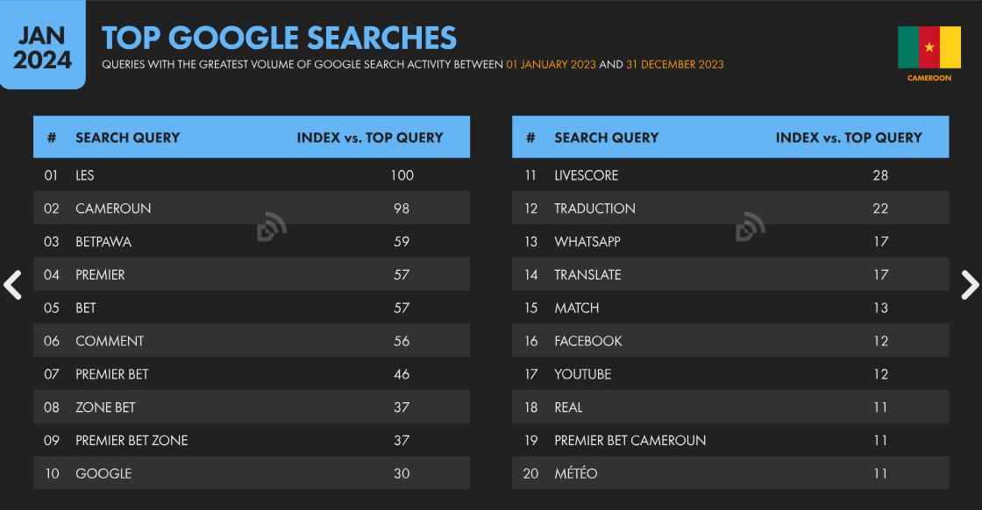
Notes:
2 CHANGE

Slide 9
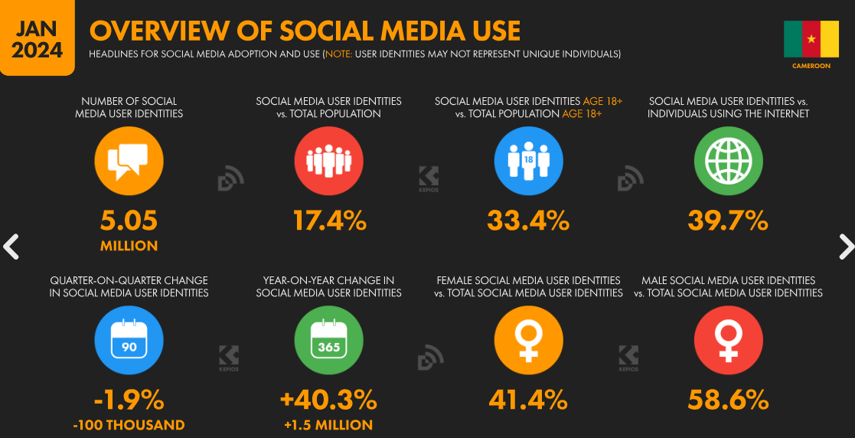
Notes:
2 CHANGE

Slide 10
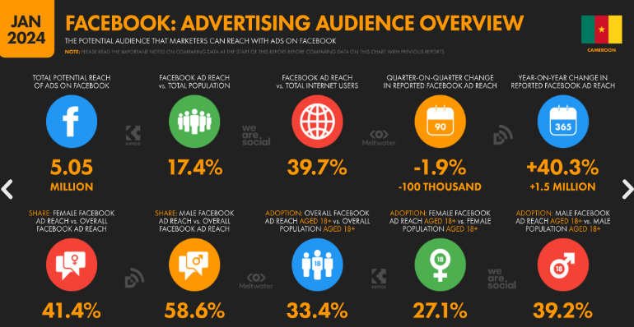
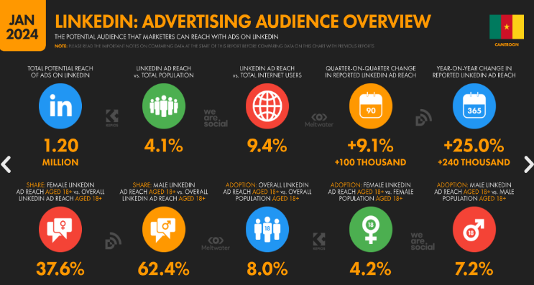
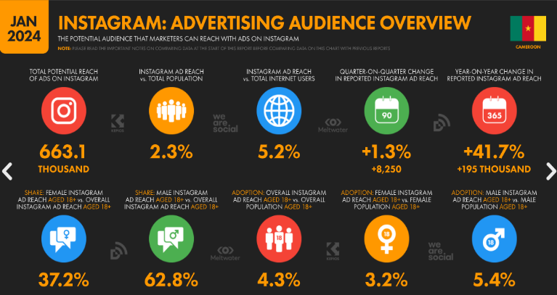
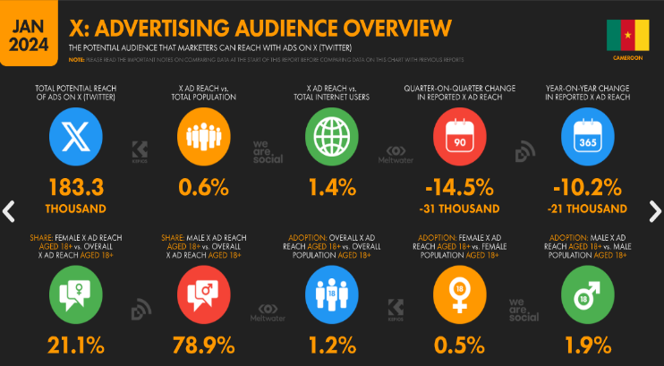
Notes:
2 CHANGE

Slide 11
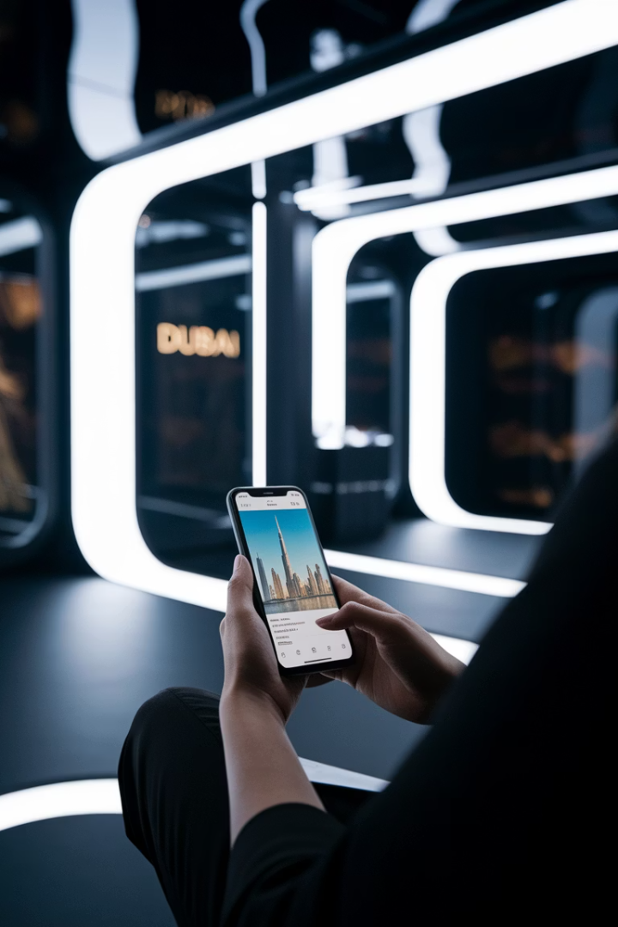




Digital Trends Shaping Travel Marketing
Short-Form Video
Immersive Content
Local Influencers
TikTok, Instagram Reels and YouTube Shorts have become primary platforms for travel inspiration and discovery.
Travel vlogs and customer testimonials in video format drive higher engagement and conversion rates.
Micro and nano influencers provide authentic social proof that resonates with Cameroonian audiences.
Mobile Bookings
Over 70% of African users access travel content via mobile, making mobile-optimised experiences essential.

Slide 12
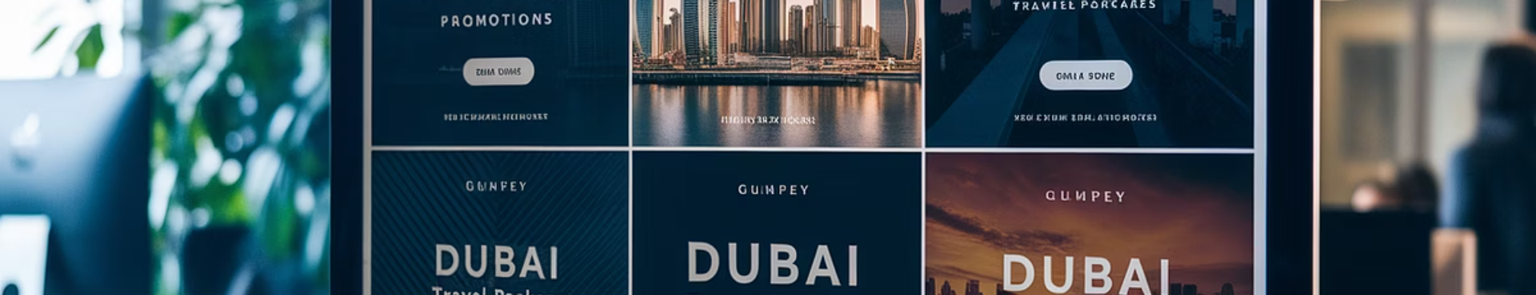
Competitive Landscape
Direct Competitors
Digital Activities
Engagement Tactics
Agencies like Dream Travel Agency, Saphir Voyages and Dubai Travel CM currently dominate the Cameroonian market for Dubai travel packages.
Competitors leverage Facebook & Instagram with sponsored flash offers, daily Stories featuring customer testimonials, and partnerships with local travel influencers.
Exclusive WhatsApp groups for promotions create a sense of community and urgency around limited-time offers.

Slide 13








SWOT Analysis
Strengths
Dubai expertise with customised packages
Weaknesses
Limited digital brand awareness
Personalised customer support
Restricted digital marketing budget to date
Deep understanding of African market needs
Opportunities
Threats
Growing mid to high-end tourism from Cameroon
Aggressive digital competition
Lack of perceived differentiation without strong brand strategy
Young, digitally-connected audience seeking new experiences

Slide 14




Digital Content Best Practices
Storytelling
Compelling traveller narratives that create emotional connection
Experience Showcase
Highlighting excursions, hotels and lifestyle elements
Video Testimonials
Authentic customer experiences in their own words
Quality Visuals
User-generated content that feels authentic and aspirational

Slide 15
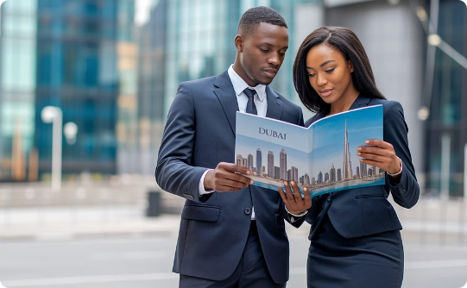
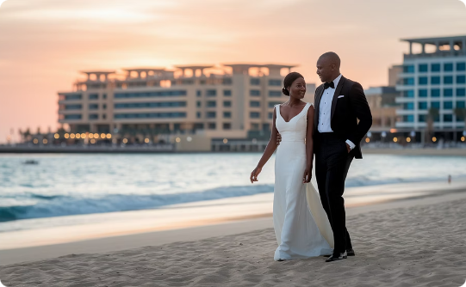
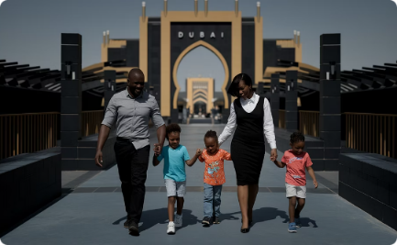
Target Audience Profiles
Young Urban Professionals
Newlyweds & Couples
Middle/High Income Families
25-40 year old urban professionals with disposable income seeking status and unique experiences. They are digitally savvy and influenced by social media trends.
Couples looking for dream vacations and romantic getaways. They prioritise memorable experiences and are willing to spend on premium packages.
Families seeking safe, organised travel experiences with activities for all ages. They value convenience and comprehensive packages.

Slide 16






Strategic Approach
Desirable Brand Universe
"The Dubai dream is accessible" through MJ Dream
Trust Ambassadors
Leverage satisfied clients and local influencers
Brand Humanisation
Authentic stories and genuine video content
Our strategic approach centres on creating an aspirational yet accessible brand image that positions MJ Dream as the trusted gateway to Dubai experiences. By showcasing real people enjoying authentic experiences, we build credibility while maintaining the aspirational quality that motivates travel decisions.

Slide 17
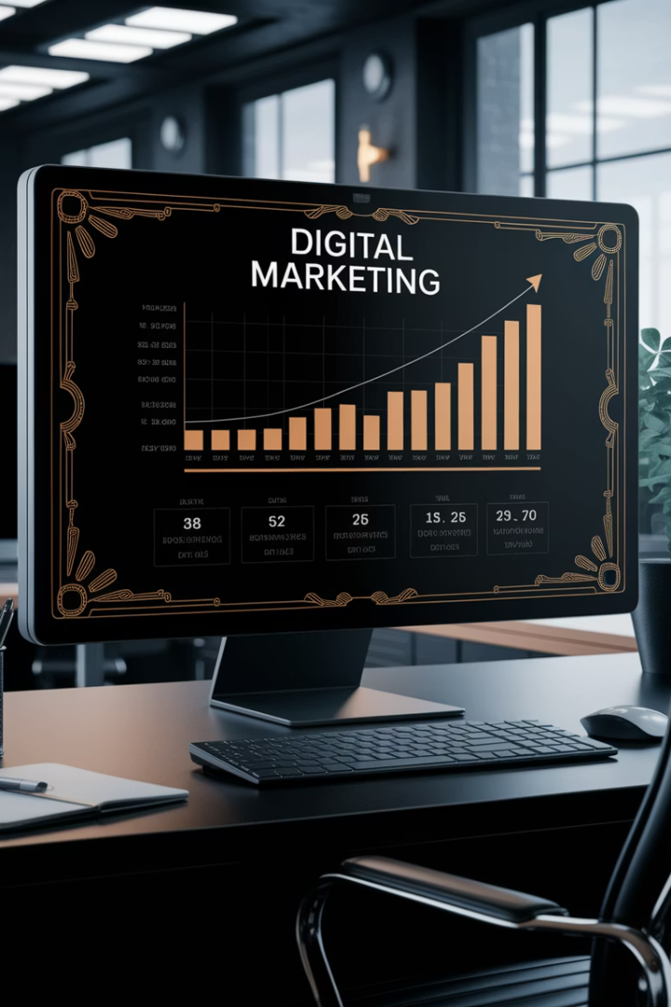
Communication & Marketing Objectives
Generate 30% more qualified leads via digital channels.
Increase brand awareness in Cameroon.
Create an engaged community on the networks.
Optimise the lead conversion rate (CRM + WhatsApp Business).

Slide 18

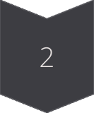



Strategic Media Mix
Facebook & Instagram Ads
Retargeting campaigns and Lookalike audiences to reach potential travellers based on existing customer profiles.
TikTok Ads
Vertical, inspirational content formats that capture attention and drive aspiration for Dubai experiences.
Google Display
Remarketing campaigns to stay top-of-mind with users who have shown interest in Dubai travel.
WhatsApp Business
Direct customer communication channel for newsletters, promotions and personalised support.
Email Marketing
Automated sequences for lead nurturing and conversion optimisation throughout the customer journey.

Slide 19
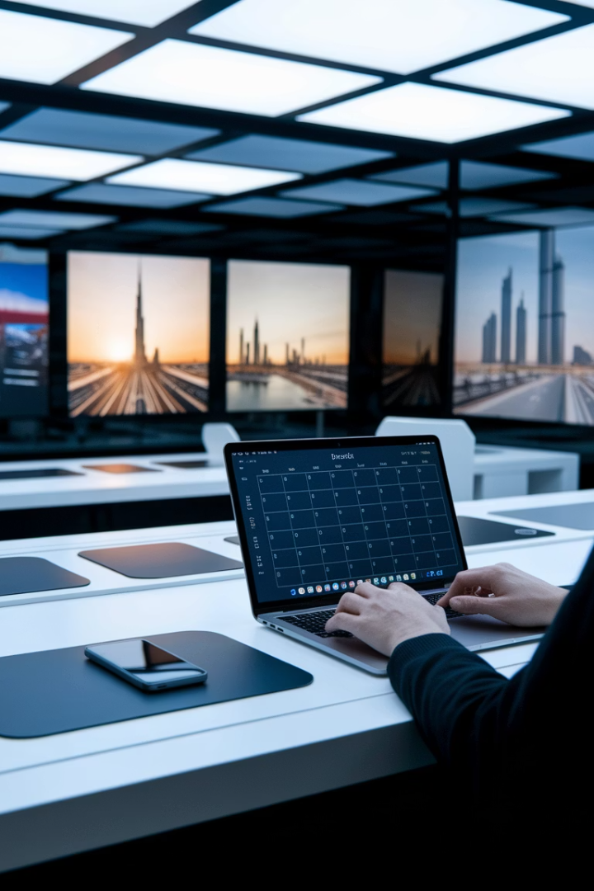
Platform-Specific Content Strategy
Platform
Content Focus
Format
Facebook
Customer testimonials, promotional offers
Posts, carousels, videos
Instagram
Behind-the-scenes, contests, visual inspiration
Reels, Stories, posts
TikTok
Experience-focused short videos (e.g., "Top 5 things to do in Dubai")
15-60 second videos
YouTube
Customer vlogs, mini-documentaries
Longer-form videos
WhatsApp
Flash promotions, customer support
Direct messages, broadcasts
Blog/SEO
Practical guides, visa FAQs
Articles, guides

Slide 20







Weekly Content Calendar
Monday: Tips & Practical Info
Visa requirements, weather updates, budget planning advice and other practical information for Dubai travellers.
Tuesday: Customer Testimonial
Video or written testimonials from satisfied clients sharing their authentic Dubai experiences with MJ Dream.
Wednesday: Weekly Offer
Promotional packages and early booking opportunities to create urgency and drive conversions.
Thursday: "Did You Know?"
Unusual facts about Dubai to educate and intrigue potential travellers about the destination.
Friday: Lifestyle Content
Humorous or lifestyle-focused Reels or TikToks to engage audiences before the weekend.
Saturday: Live Session or FAQ
Interactive content addressing common questions and concerns about Dubai travel.
Sunday: UGC or Inspiration
Reposting user-generated content or sharing inspirational Dubai imagery to spark wanderlust.

Slide 21
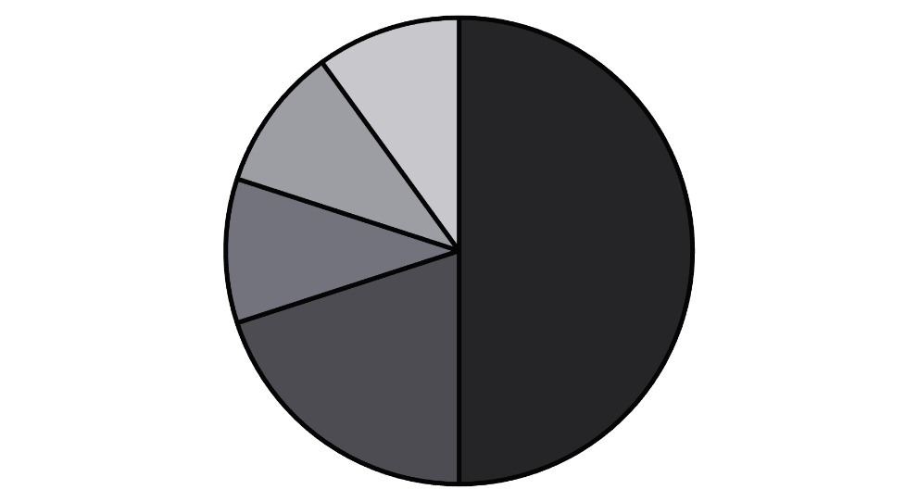
Advertising Budget Allocation
Facebook & Instagram
TikTok
YouTube
WhatsApp CRM
Influencers
The total advertising budget for the 6-month campaign ranges from €5,000 to €8,000. Facebook and Instagram receive the largest allocation (€2,500) due to their high reach and targeting capabilities. TikTok receives €1,000 to capitalise on growing video consumption, while YouTube, WhatsApp tools, and influencer partnerships each receive €500.

Slide 22
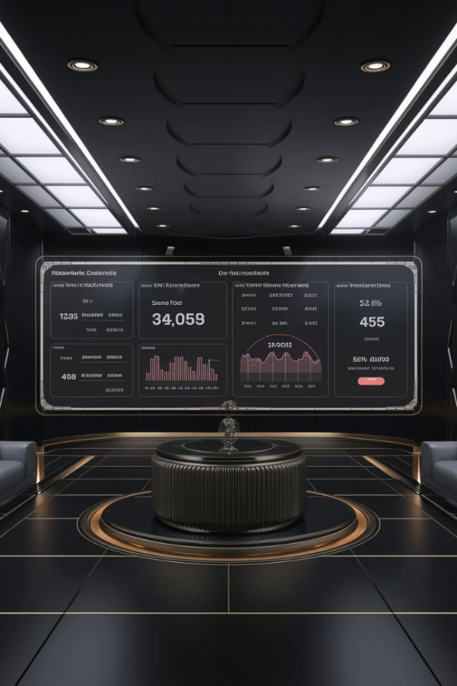
Key Performance Indicators
Awareness Metrics
Engagement Metrics
Reach and impressions across platforms
Social media engagement (likes, shares, comments)
Brand mention frequency
Click-through rates (CTR) on campaigns
Follower growth rate
Video completion rates
Conversion Metrics
Lead generation (form submissions and WhatsApp inquiries)
Conversion rate from contact to sale
Email open rates and WhatsApp response rates

Slide 23
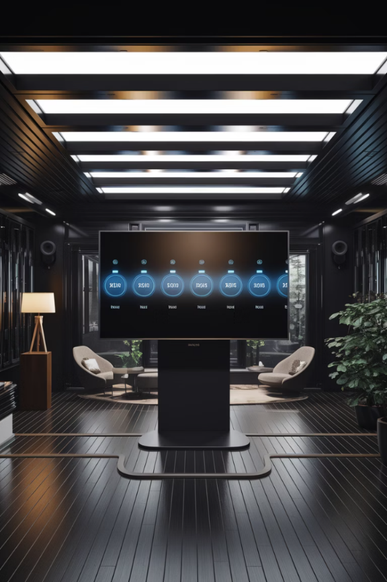
Implementation Timeline
Month 1: Preparation Phase
Development of strategy, content creation, and establishing influencer partnerships to build a strong foundation for the campaign launch.
Month 2: Awareness Campaign
Launch of brand awareness initiatives across platforms with regular content publishing to establish presence and begin building audience engagement.
Months 3-5: Acquisition & Conversion
Intensified focus on lead generation and conversion optimisation, with continuous refinement of ad campaigns based on performance data.
Month 6: Evaluation & Relaunch
Final campaign push alongside comprehensive performance analysis and development of recommendations for future strategy.

Slide 24
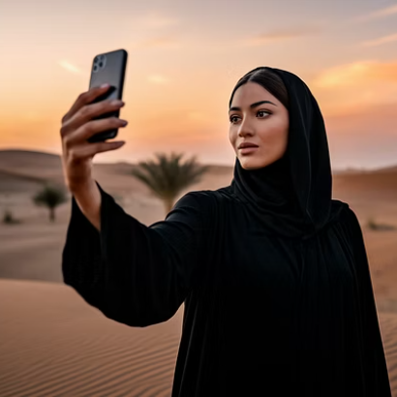
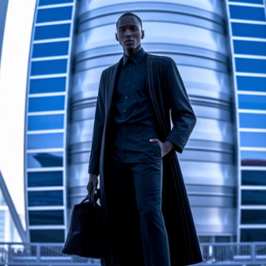
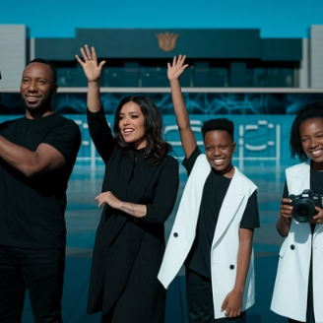
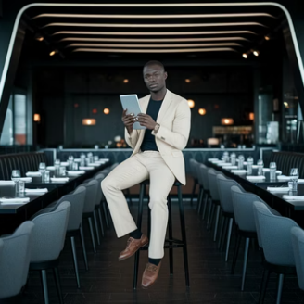
Influencer Partnership Strategy
Our influencer strategy focuses on authentic partnerships with Cameroonian content creators who resonate with our target audience. We'll prioritise micro and nano influencers (5,000-50,000 followers) who have high engagement rates and credibility within specific niches like travel, lifestyle, fashion, and family content.
These partnerships will include sponsored trips, content co-creation, and affiliate arrangements where influencers receive commission for bookings generated through their unique codes, ensuring alignment of incentives.

Slide 25
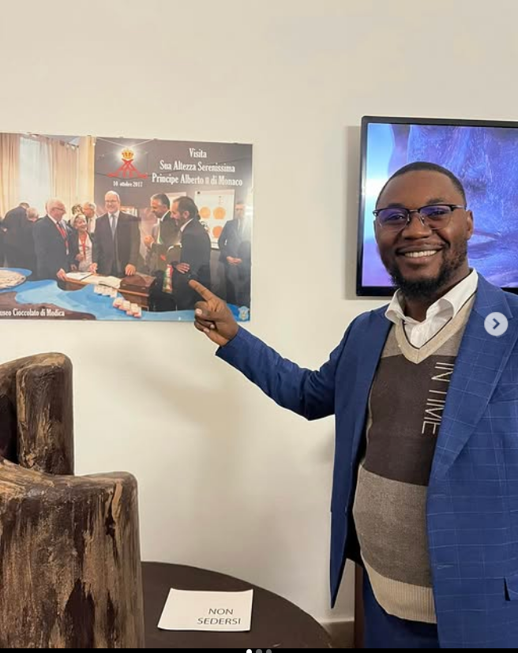
TikTok Travel Specialists
Mac Donald Kom
A prominent travel content creator with 606,000 followers and 937,000 likes on TikTok. His authentic content focuses on Cameroonian tourism, making him ideal for promoting Dubai travel experiences.
https://www.instagram.com/global_travel_servives/
https://www.tiktok.com/@macdonaldkom?_t=ZM-8vnzV2SJT9x&_r=1
With 446 publications, he has demonstrated consistent engagement with his audience through genuine travel documentation.

Slide 26
TikTok Travel Specialists
Samira Doubaï
Specialising in Middle Eastern destinations, Samira has built a community of 106,000 followers with 622,000 likes across 949 TikTok publications.
Her existing expertise on Dubai makes her particularly valuable for targeted campaigns, offering authentic insights into the destination.

Slide 27
TikTok Travel Specialists
The Charles Diaries
With nearly 105,000 Instagram followers, this travel influencer shares detailed experiences and practical advice for travellers.
His targeted audience of travel enthusiasts makes him an excellent partner for promoting Dubai itineraries and experiences.

Slide 28

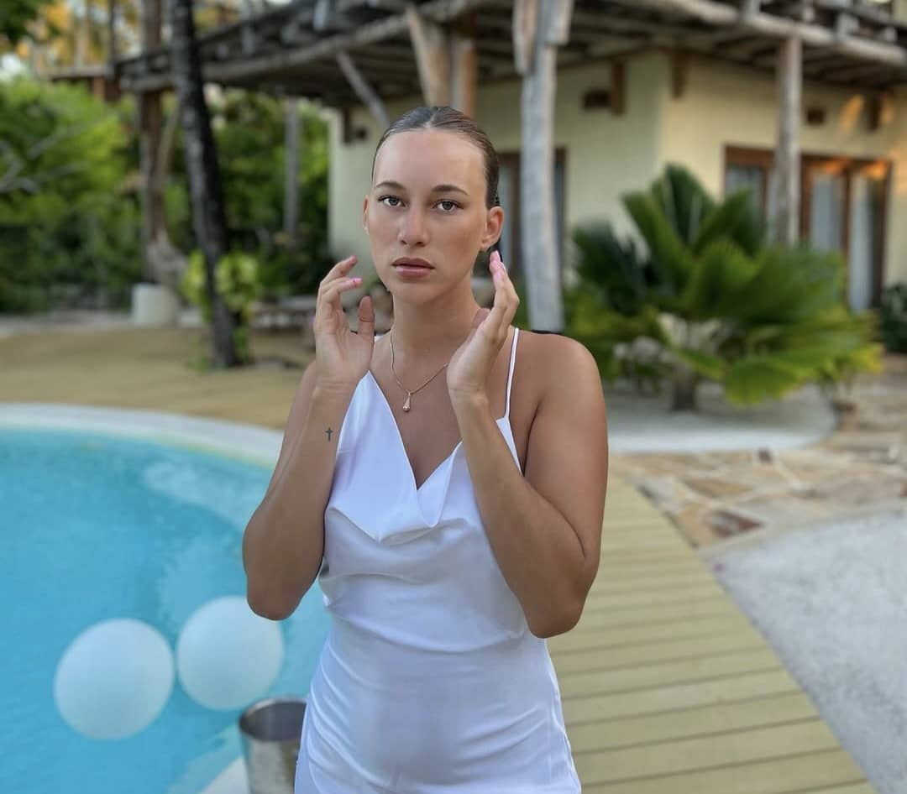
Multi-Platform Lifestyle Influencers
Kimberly Biziou
Audience on Instagram : 307k followers
Profession & Editorial Line : Kimberly Biziou, known as Kimy B, is a Franco-Cameroonian content creator, actress, and brand ambassador. She is passionate about promoting Cameroonian culture and tourism through her travel vlogs and social media content.
Potential Contribution : Kimy B's engaging storytelling and visual content can showcase Dubai's attractions to her audience, drawing parallels between Cameroonian and Emirati cultures. Her influence can inspire her followers to explore Dubai, thereby increasing the travel agency's clientele.

Slide 29

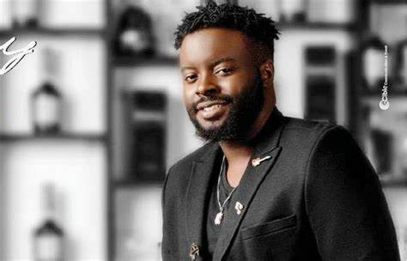
Multi-Platform Lifestyle Influencers
LOCKO
Audience on Instagram : 1,1M followers
Profession & Editorial Line : Charles Arthur Locko Samba, known as Locko, is a renowned Cameroonian singer, songwriter, and producer specializing in R&B and Afropop. He has achieved significant milestones, including becoming the first Cameroonian-based artist to reach 1 million monthly listeners on Spotify. ​
Potential Contribution : Locko's international music career and substantial fan base can be instrumental in promoting Dubai as a vibrant destination. Collaborations or endorsements from him can enhance the travel agency's visibility and appeal.

Slide 30

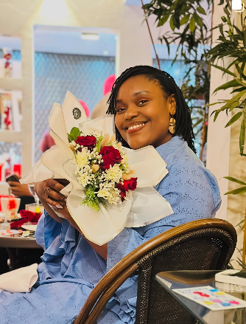
Multi-Platform Lifestyle Influencers
Dona Beey
She shares on Instagram, aesthetically pleasing visuals, luxury lifestyle moments, and travel experiences that appeal to a young, aspirational audience in Cameroon and beyond. She has 13.2k followers and 702 publications;
She has strong influence among Cameroonian youth interested in travel and luxury experiences;
Her content aligns with the aspirational lifestyle that a Dubai travel brand would want to promote;
She could serve as a local brand ambassador, creating engaging content and building trust among potential Cameroonian travelers;
Perfect for Instagram takeovers, sponsored posts, and destination storytelling.

Slide 31

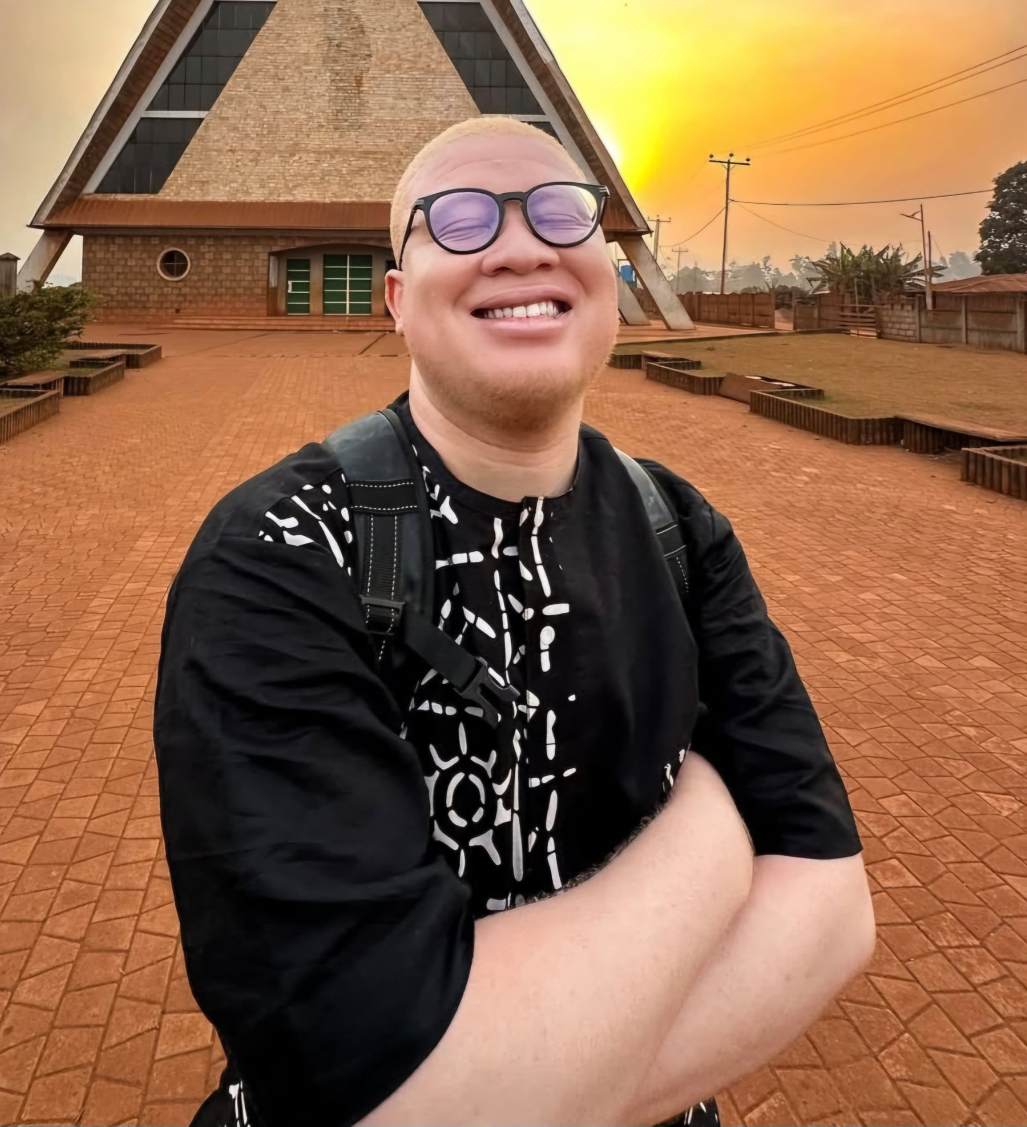
Multi-Platform Lifestyle Influencers
Loïc Abondo
Audience on Instagram : 10,9k followers
Profession & Editorial Line: Loïc Abondo has studied in Organizational Communication and he is National Audiovisual Production Officer at French Institute of Cameroon. He is passionate about culture and photography, often writing articles that highlight Cameroonian arts and events. ​
Potential Contribution: Loïc's expertise in cultural journalism and photography can be leveraged to create compelling narratives and visuals about Dubai's cultural scene, appealing to Cameroonian travelers interested in arts and heritage.

Slide 32

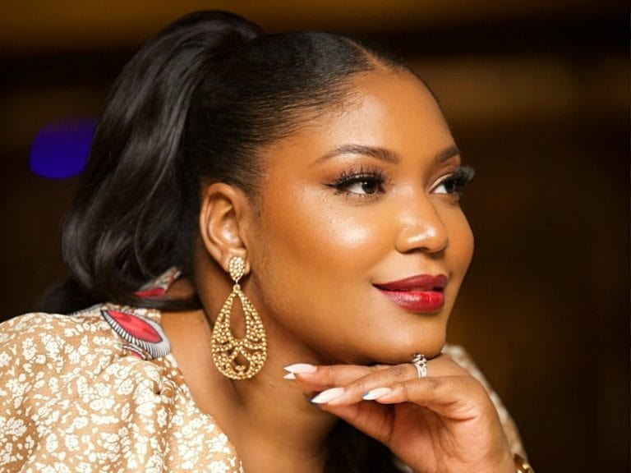
Multi-Platform Lifestyle Influencers
Ange Mbayen
Audience on Instagram : 9869 followers
Profession & Editorial Line: Ange Mbayen is a dynamic Cameroonian entrepreneur and content creator. She is the founder of Bold Make Up, a premium makeup brand, and has launched initiatives like the Beauty Hub app and the mini-series "The Boldies" to empower women and promote beauty standards. ​
Potential Contribution: Ange's entrepreneurial spirit and focus on empowerment align well with promoting Dubai's luxury and wellness offerings. Her endorsement can attract clients interested in beauty and self-care experiences in Dubai.

Slide 33
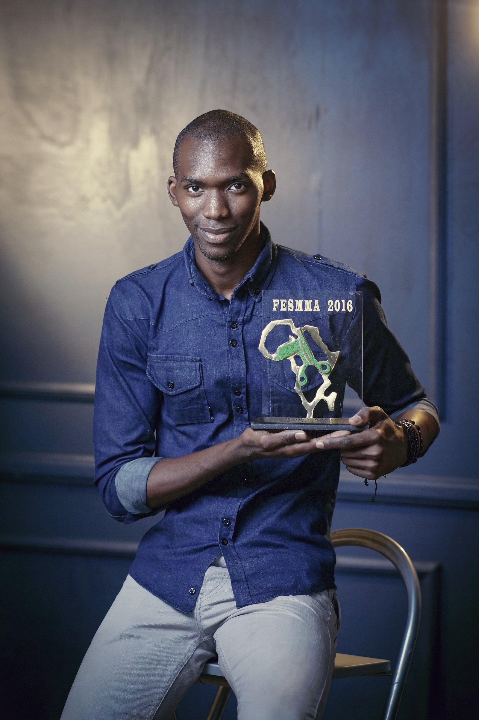
Multi-Platform Lifestyle Influencers
Freddy Manyongo
Audience on Instagram : 20,1k followers
Fredy Manyongo is a Cameroonian model and the promoter of the “Mboti” event, a cultural and lifestyle initiative that celebrates African identity and creativity.
With a strong presence both online and offline, Fredy has built a unique personal brand that blends fashion, lifestyle, and cultural pride. His editorial line is centered on style, self-expression, event promotion, and showcasing African excellence.
Thanks to his growing influence and charismatic image, Fredy is the ideal brand ambassador for a travel agency looking to establish itself in Dubai. His connection with a young, vibrant, and aspirational audience—especially across the Cameroonian and African diasporas—makes him a powerful voice to build trust and visibility for the brand.
Through strategic collaborations, curated content, and on-the-ground activation, Fredy can help the agency increase brand awareness, inspire travel dreams, and connect with a niche market seeking authentic and premium experiences in Dubai and beyond.
These multi-platform creators reach diverse audiences through various content formats. Their established credibility in lifestyle, entertainment and luxury niches makes them valuable partners for showcasing the full Dubai experience beyond just tourist attractions.

Slide 34
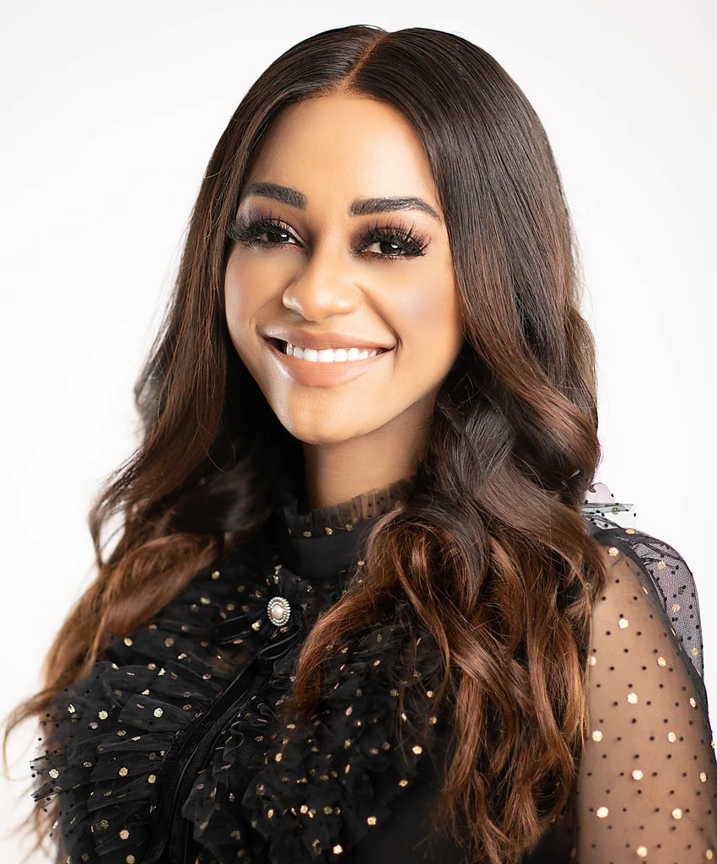
Multi-Platform Lifestyle Influencers
Maggy’s editorial line aligns perfectly with the travel industry—she shares lifestyle content, travel experiences, and business tips. Her audience already follows her for recommendations on places to visit, stay, and explore. As a Cameroonian content creator, she knows the local culture, preferences, and digital behaviors. She can tailor your message in a way that speaks directly to the hearts of Cameroonian travelers. Through high-quality photos, engaging Reels, and authentic travel vlogs, Maggy can showcase the unique offers and services of the agency, building trust and curiosity among potential customers.
Kilama Marguerite
Most knowing Maggy Kloset, a fashion brand known for its stylish and contemporary clothing. On Instagram, she has 91.2K followers and her editorial line focuses on lifestyle, travel, and business. Passionate about design elegance and travels, she combines creativity and entrepreneurial spirit to offer unique fashion pieces that reflect modern African flair. Maggy Kloset has a strong digital presence in Cameroon. Her influence can help create immediate brand awareness and interest around the new travel agency.

Slide 35
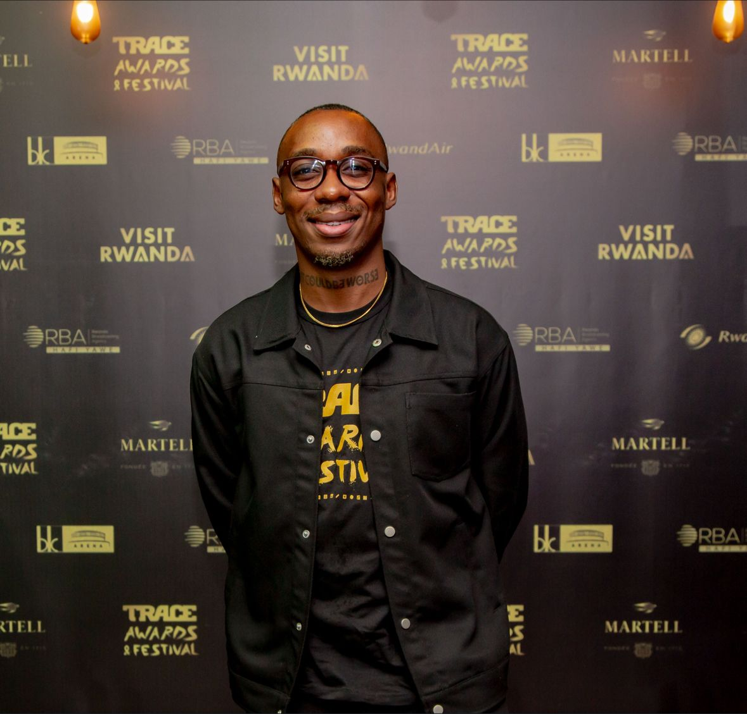
Multi-Platform Lifestyle Influencers
Jim-Kévin Moukoury
Jim-Kévin Moukoury is a Cameroonian digital marketing consultant and entrepreneur. He specializes in brand strategy, influencer marketing, and business development across Francophone Africa. He has 12,7k followers on Instagram ;
For MJ Dream Travel & Tourism :
- Can help position the brand locally through targeted digital campaigns, influencer partnerships, and strategic market entry plans tailored to Cameroonian consumers;
- His expertise bridges international brands with the local audience for effective visibility and conversion.

Slide 36

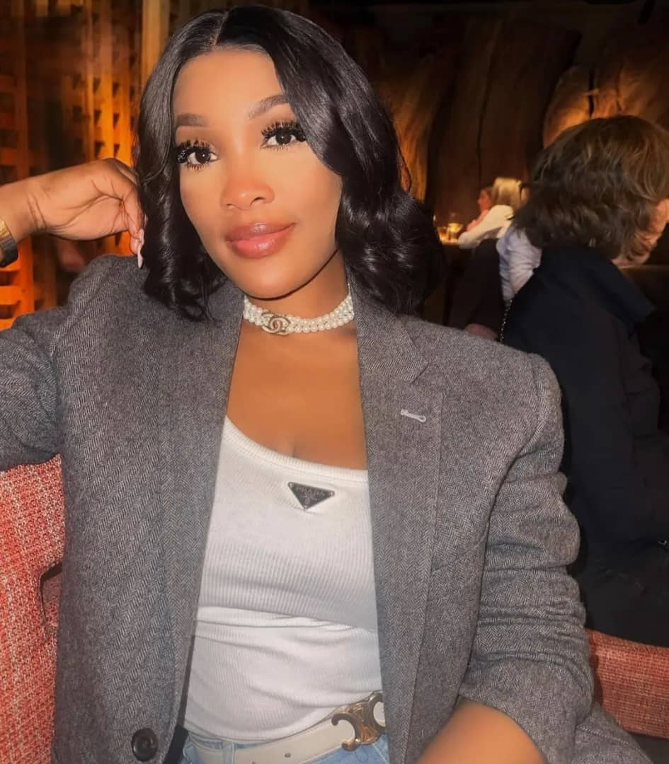
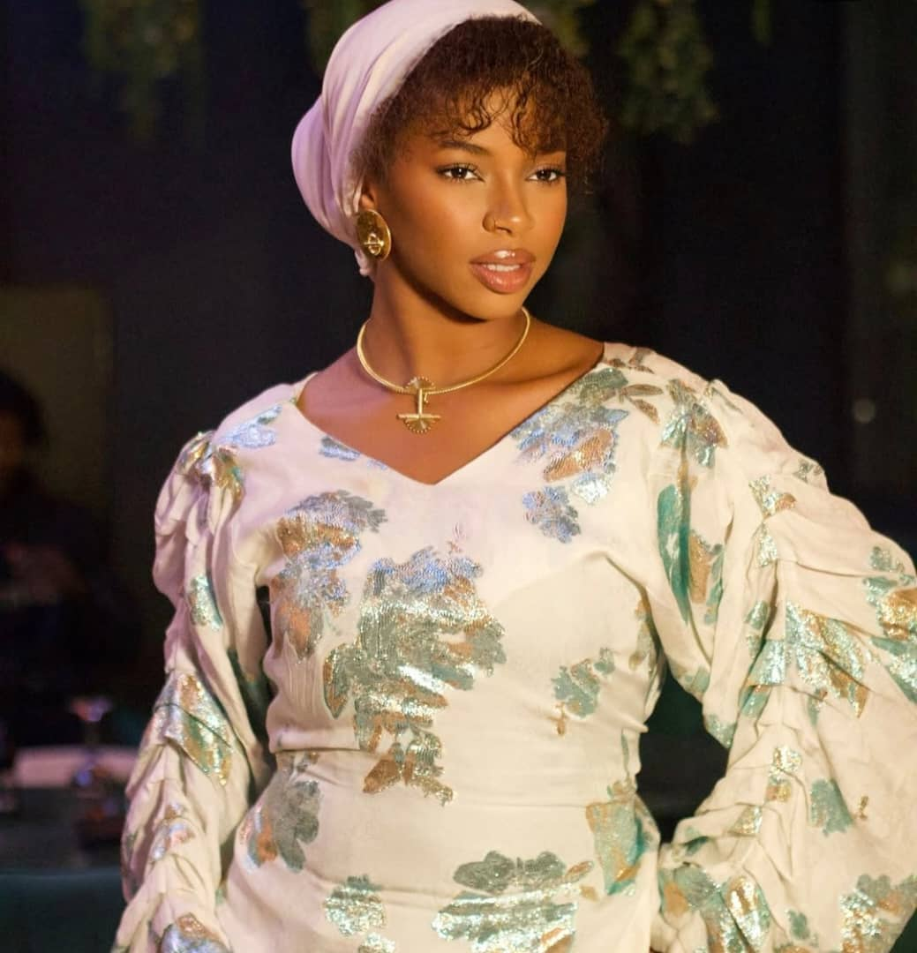
Multi-Platform Lifestyle Influencers
Iris Kenfack
Mourzane Ousmanou
• Audience on Instagram : 341K followers;
• Benefit : she is a lifestyle influencer with a strong online presence, ideal for promoting premium travel experiences.​
• Audience on Instagram : 110K followers;
• Benefit : A digital marketing expert, capable of producing engaging and informative content about MJ Dream’s services.

Slide 37
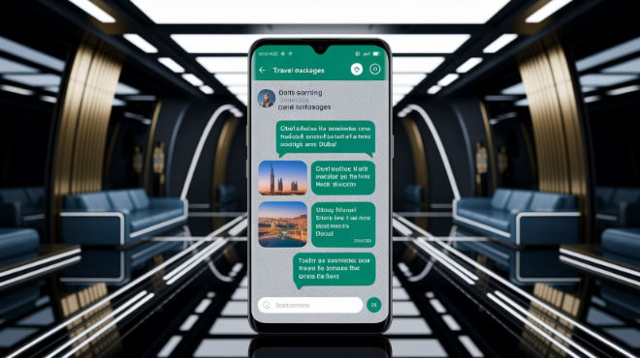
WhatsApp Business Strategy
Customer Journey Integration
WhatsApp Business will serve as a central communication hub throughout the customer journey, from initial inquiry to post-trip feedback. The platform's 98% open rate makes it significantly more effective than email for time-sensitive communications.
We'll implement automated welcome messages, quick replies for common questions, and broadcast lists for promotional content, while maintaining the personal touch through direct agent conversations for complex inquiries.
Exclusive Content Distribution
We'll create VIP WhatsApp groups for past customers and high-intent prospects, providing them with exclusive flash deals, behind-the-scenes content, and early access to new packages, fostering a sense of community and exclusivity.

Slide 38




Content Creation Workflow
Planning
Creation
Review
Publishing
Weekly content calendar development
Visual asset production
Quality assurance checks
Scheduled posting across platforms
Copywriting and scripting
Brand consistency verification
Theme and messaging alignment
Video filming and editing
Factual accuracy confirmation
Initial engagement monitoring
Paid promotion activation
Platform-specific adaptation

Slide 39

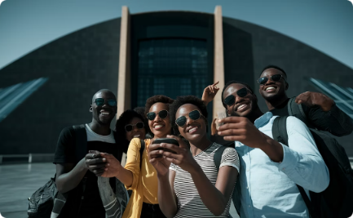
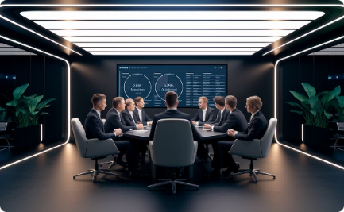
Expected Outcomes & Next Steps
Measurable Growth
Enhanced Customer Experience
Continuous Optimisation
Implementation of this strategy is expected to deliver a 30% increase in qualified leads, 25% improvement in conversion rates, and significant growth in brand awareness metrics across Cameroon's key urban centres.
Monthly performance reviews will allow for agile strategy adjustments based on real-time data, ensuring optimal resource allocation and maximising return on marketing investment throughout the campaign.
The personalised approach through WhatsApp Business and targeted content will create a seamless customer journey from inspiration to booking, resulting in higher satisfaction rates and increased referrals.

Slide 40
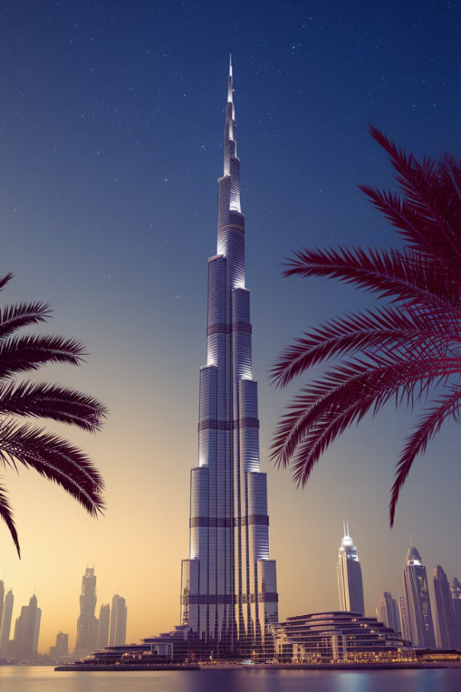
Customer
experience
Welcome in Dubai
Imagine a night where walls fade away to reveal Emirati palaces. A space transformed into a luxurious oasis. The scent of incense, oriental songs, and warm sand beneath your feet.
An exclusive night event where every guest becomes a traveller in a world of unparalleled opulence.

Slide 41
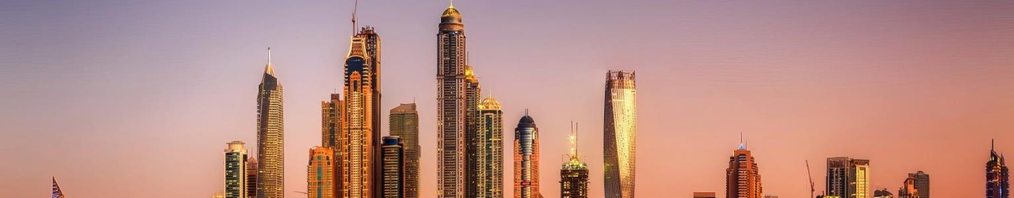
Our Distinguished Guests (About 150 invitees)
Families
Business Elite
Adventure-loving households seeking extraordinary escapes and lifetime memories.
Executives pursuing refined experiences beyond the boardroom.
Influencers & Media
VIP Clientele
Lifestyle creators and celebrities with discerning taste and global reach.
Loyal customers and qualified prospects identified through our networks.

Slide 42
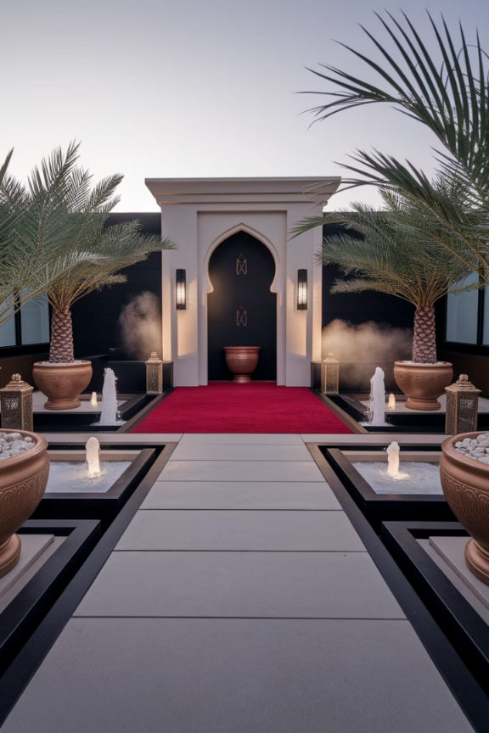



A Breathtaking Venue
Monumental Oriental Entrance
Date Palm Walkways
Pathways lined with majestic palms and ambient Thousand and One Nights lighting.
Guests are transported instantly to the Emirates upon arrival.
Sensory Elements
Red carpets, elegant fountains, and gentle mist create total immersion.

Slide 43
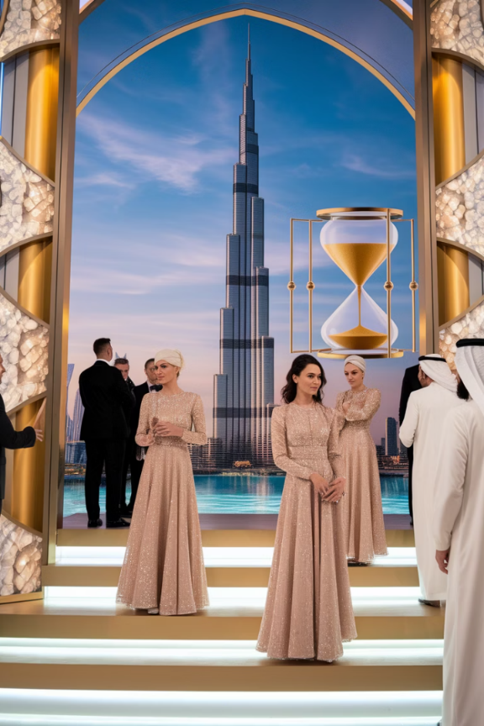



Royal Welcome Experience
Traditional Greeting
Hostesses in abayas and keffiyehs welcome each guest with authentic hospitality.
Burj Khalifa Experience
Stunning photocall with augmented reality backdrop of Dubai's iconic skyline.
Golden Hour Gift
Each guest receives a small vial of golden sand symbolising their impending journey.

Slide 44
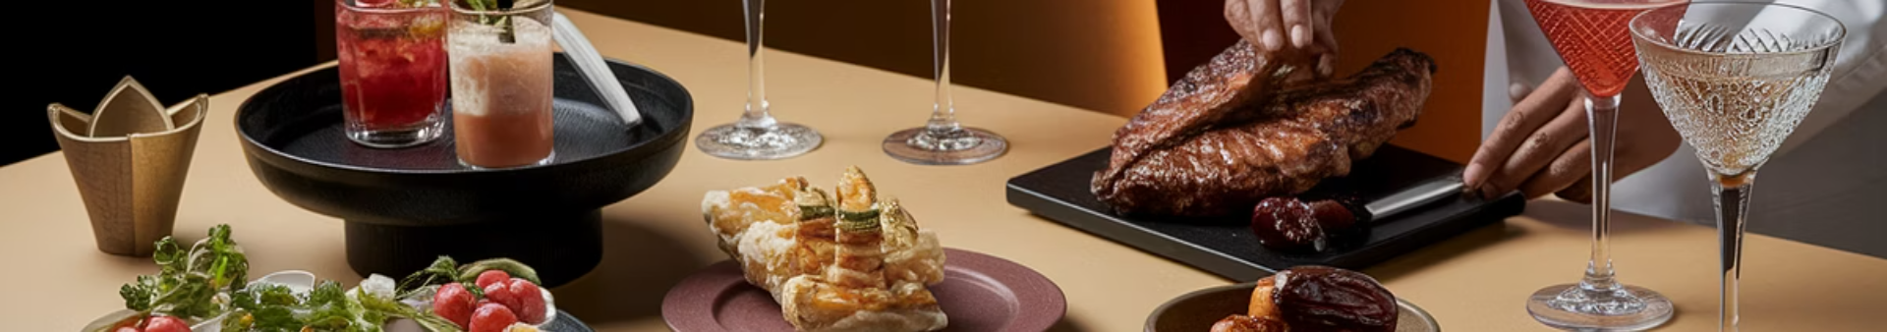



Culinary Journey Through Dubai
Emirati Delicacies
Mezze, authentic grills, dates, and perfumed camel milk served with flair.
Desert-Inspired Cocktails
Unique libations capturing the essence of Arabian nights.
Live Cooking Experience
Master chefs create Dubai street food specialties before your eyes.

Slide 45
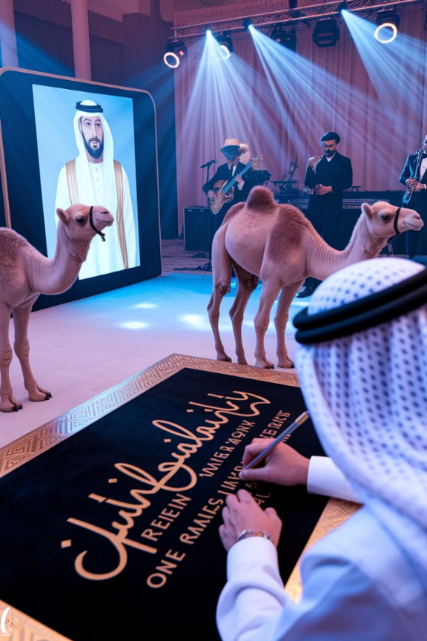
Sensory Oasis
Fragrance Journey
Immerse yourself in a world of oud, musk and desert rose essential oils.
Expert perfumers guide you through Dubai's signature scents.
Arabian Nights Lounge
Relax in our Bedouin-inspired tent with traditional hookahs.
Be mesmerised by enchanting oriental dancers and live musicians.

Slide 46



Technological Marvels
Virtual Reality
Fly over Dubai's landmarks with immersive VR technology
360° Projections
Surround yourself with stunning vistas of beaches and deserts
Luxury Showcases
Explore Dubai's finest accommodations and exclusive experiences

Slide 47
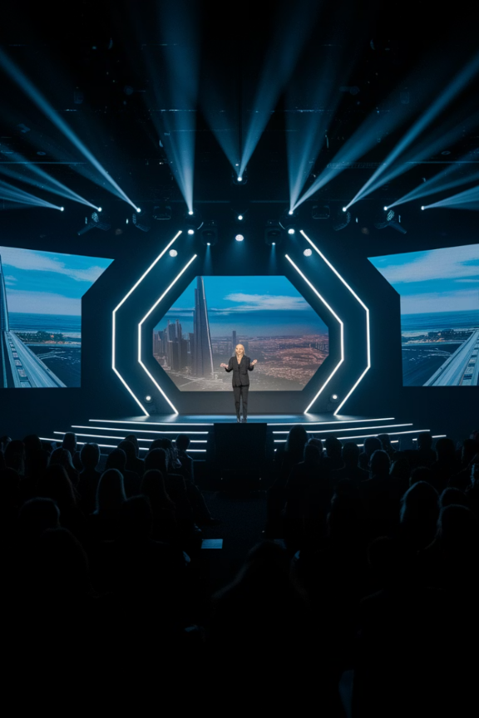

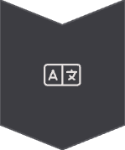

The MJ Dream Travel Experience
Emotional Film
"Dubai: Where All Dreams Are Possible"
Founder's Vision
Personal stories and client testimonials
Exclusive Packages
One-night-only promotions for families and groups

Slide 48



Chance to Win Dubai Dreams
Special Prize
Complete Dubai journey for two with all luxuries included
Secondary Treasures
Exclusive discounts and oriental keepsakes
Fragrance Collection
Exquisite perfume sets to evoke Dubai's essence

Slide 49


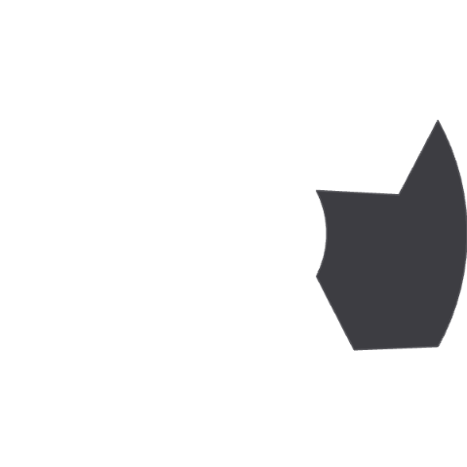








Project Team Structure
Digital Project Manager
Community Manager
Overall campaign coordination and strategy implementation
Content creation and social media engagement
Graphic Designer/Videographer
Influence Manager
6
Influencer relationship coordination
Visual content production across platforms
CRM Specialist
Traffic Manager
Lead management and follow-up processes
Advertising campaign management and KPI tracking

Slide 50
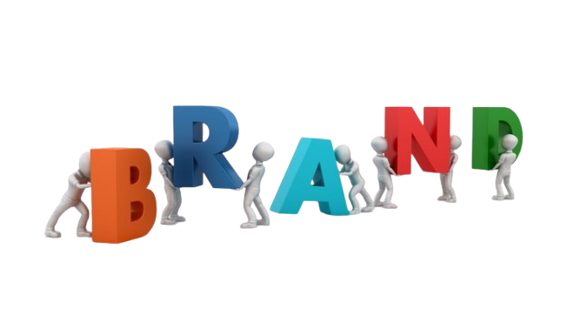
Co-branding
Le co-branding est une stratégie marketing qui rassemble
deux marques distinctes et indépendantes dans la création
d'une nouvelle offre de produit ou service.
Pourquoi le co-branding?
Il permet d’accroitre la visibilité d’une marque en
bénéficiant de l’audience de la marque partenaire
Gagner davantage en crédibilité grâce à une
association stratégique
3. Réduire les coûts marketing et accéder à un nouveau marché

Slide 51

Co-branding
Partners
The Boldies
The Boldies est une web série Camerounaise produite par
la marque de maquillage Bold Makeup. Elles organisent
également des évènements IRL pour promouvoir la série,
le women empowerment.
https://www.youtube.com/@boldmakeup237
https://www.instagram.com/theboldiescm/

Slide 52

Co-branding
Partners
The Boldies
Pourquoi The Boldies?
La cible: Jeunes femmes (25–35 ans), digitales, influenceuses
/prescriptrices ou aspirant au style de vie présenté dans la série.
Elles sont très sensibles à l’affirmation de soi, la réussite,
la liberté de voyager et habituées à consommer via les
réseaux sociaux
Elles sont prêtes à payer pour des expériences de qualité,
surtout si elles s’y sentent représentées
Ce sont des voyageuses potentielles idéales !
Comment activer?
Intégrer MJ Dream dans la narration: l’un des personnages
principaux vit
à Dubai et pourrait y inviter ses amies via MJ Dream (Bold In Dubai/
The Boldies Take Dubai)
Sponsoriser l’un des évènements

Slide 53


Co-branding
Partners
Bold Makeup
Bold Makeup est une marque de maquillage Camerounaise
(créée en France) en 2015 pour les peaux noires – mattes –
métissées, Cette marque
Pourquoi Bold Makeup?
Le makeup et le voyage parlent à la même cible : femmes jeunes,
actives, digitales, soucieuses de leur image
Les deux univers vendent du rêve, de la confiance, de l’empowerment
Possibilité de bénéficier de son réseau de partenaires
Bold Makeup organise régulièrement des évènements.

Slide 54

Co-branding
Partners
Bold Makeup
Comment activer?
Créer une collection en partenariat avec MJ Dream
Visibilité lors des évènements de Bold Makeup
Co-création de contenus

Slide 55


Co-branding
Partners
Il s’agit d’un beach club éphémère qui a lieu chaque fin
d’année sur les berges du wouri.
Pourquoi Coco Beach?
l’évènement réunit des hommes et femmes
(25–50 ans), aspirant à l’ascension sociale
mais aussi des élites amoureux d’expériences exclusives
Visibilité auprès d’un public captif en quête d’évasion
Opportunité de présenter ses offres dans un contexte
non commercial
Contenu visuel fort pour communication digitale
Activation
Soirée spéciale Dubai sponsorisée par MJ Dream
Visibilité sur les supports de communication
Coco Beach

Slide 56

Co-branding
Partners
Agences de voyage
Création de partenariats avec des agences de voyage
présentes au Cameroun.
Objectifs
Étendre notre réseau de distribution local avec des
prescripteurs déjà implantés
Créer un effet de levier commercial avec des partenaires
déjà en contact avec les clients
Crédibiliser MJ Dream sur le terrain, en montrant qu’elle a
un réseau réel
Comment activer?
Créer un pack visuel et argumentaire pour faciliter la vente
Lancer un challenge de vente avec primes, voyages, bons d’achat
Installer un corner MJ Dream dans les agences physiques
(kakemonos, flyers, écran promo)

Slide 57
DIGITAL MARKETING BUDGET
SERVICES | DESCRIPTIONS | OBSERVATIONS
Consulting / digital Media / digital planning Content proposal / creative (static)Language & format / country adaptation Monthly reporting Media review (quarterly)Weekly alignment meeting Media buying and campaign optimization | Monthly (report) Monthly (dedicated resource)1 Animatic & 12 static /page/ month Per campaign Full month Once a month Once a month Weekly with the digital team Per campaign with the key account manager | The purchase of art is not included in this cost. Unlimited access to the agency's file-sharing platform for all countries and all campaign partners
Expense items | Monthly Budget (Dollars)
Digital Display | 2 000
Social media Campaign | 1 500
SEO Optimisation | 1 500
Influencer program | 4 000
Agency fees/Month | 5 000
Total | 14 000

Slide 58
EVENT
ESTIMATED
BUDGET

Slide 59

Merci.
MARKETING STRATEGY

